Slide 1

TMO Modernization - Solution Architect Sync-Up AWS Cognito Federation to Okta
With FOCUS on Spring Security, oauth/oidc Token Patterns, PKCE for oauth2

Slide 2
Main questions
Can we use Okta as federated Identity with Cognito ? yes
What token exchange patterns can we use ?
How can we improve security ?
Can we use it with PKCE for OAuth 2.0 ?
Can we use for client-credentials methods: jwt-bearer or jwt-private authentication

Slide 3
Apps developed to Answer MAIN QUESTIONS:
Oauth2-protocol-patterns application
The client is a set of Spring-Boot Applications
AWS Cognito, S3, CloudFront application.
The client is a plain vanilla JavaScript application

Slide 4
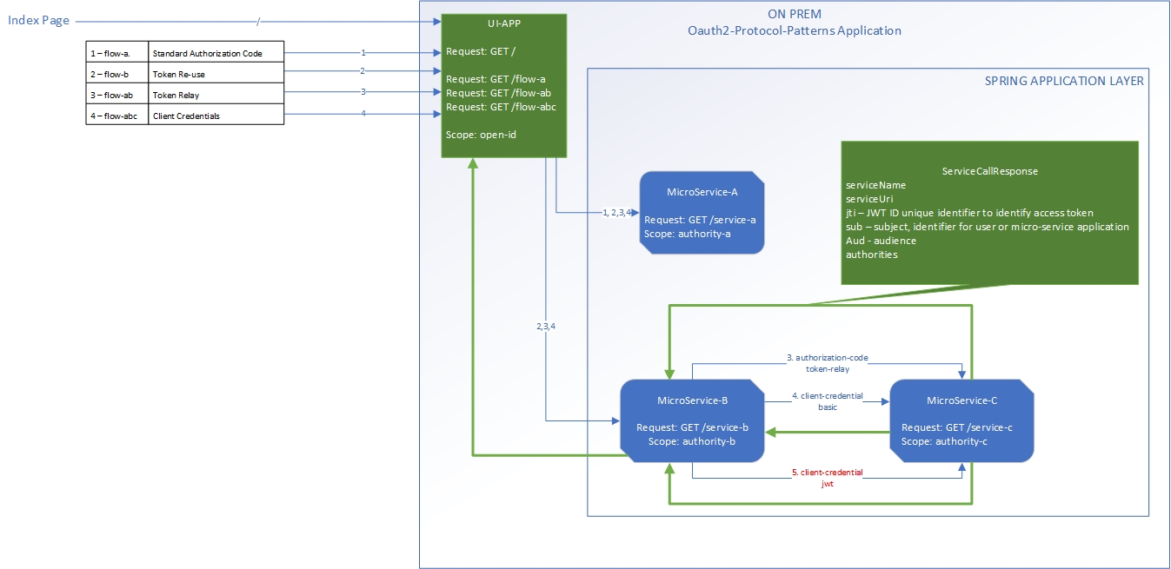
Application Flow

Slide 5
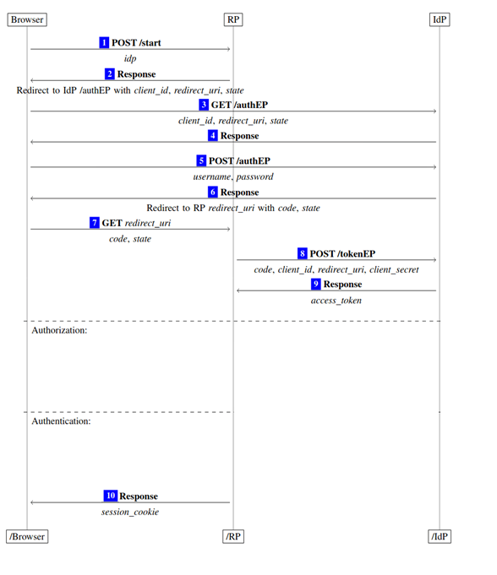
Review oPENid/oauth2 Code Grant Flow
EP – Endpoint
IdP – Identity Provider
RP – Resource Provider

Slide 6
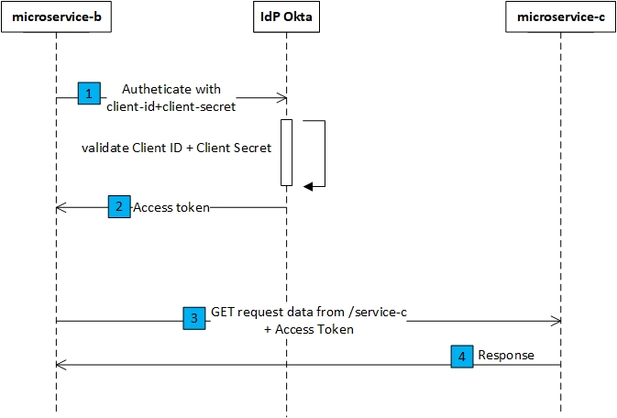
Review oPENid/oauth2 BaSIC client credential Flow

Slide 7
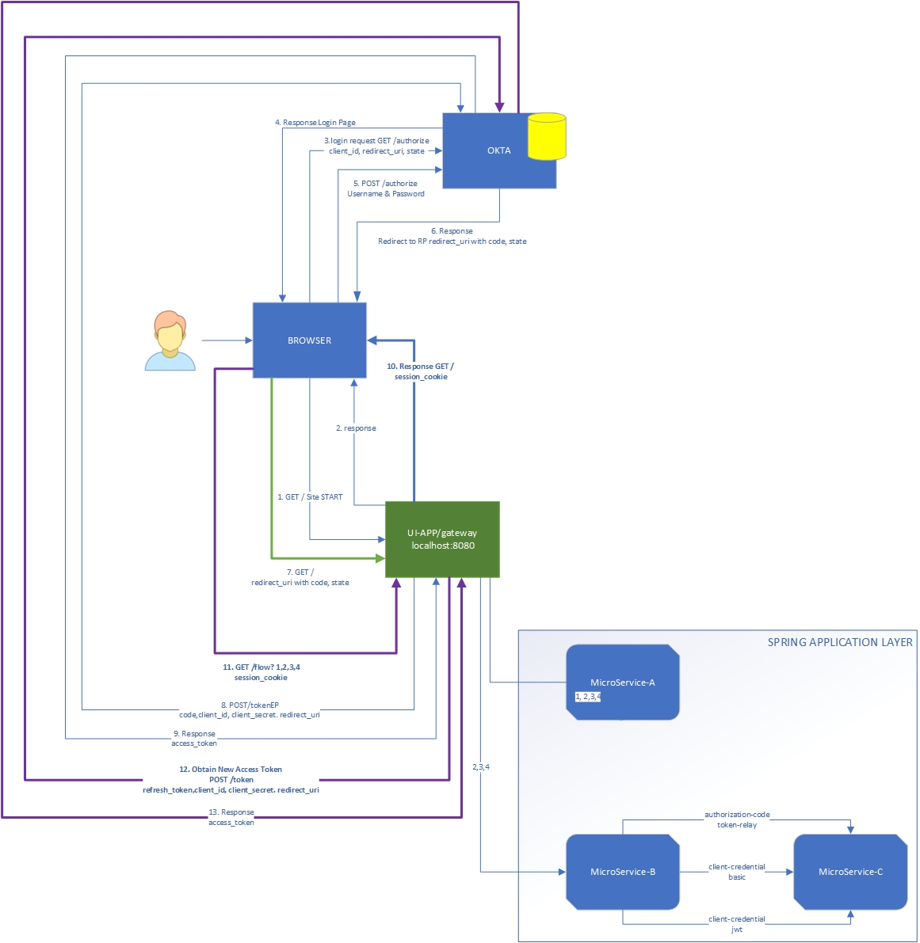
The OAUTh2 flow topology Diagram with Okta as IDP ?

Slide 8
Demo with Okta as IDP
Show Okta Configuration
Users
Groups
Apps
Authorization Server
http://localhost:8080

Slide 9
Demo with Aws Cognito as IDP and federation
Show Cognito Configuration
User Pool
Apps
Notice Scope is different using Resource Identifier.
http://localhost:8080

Slide 10
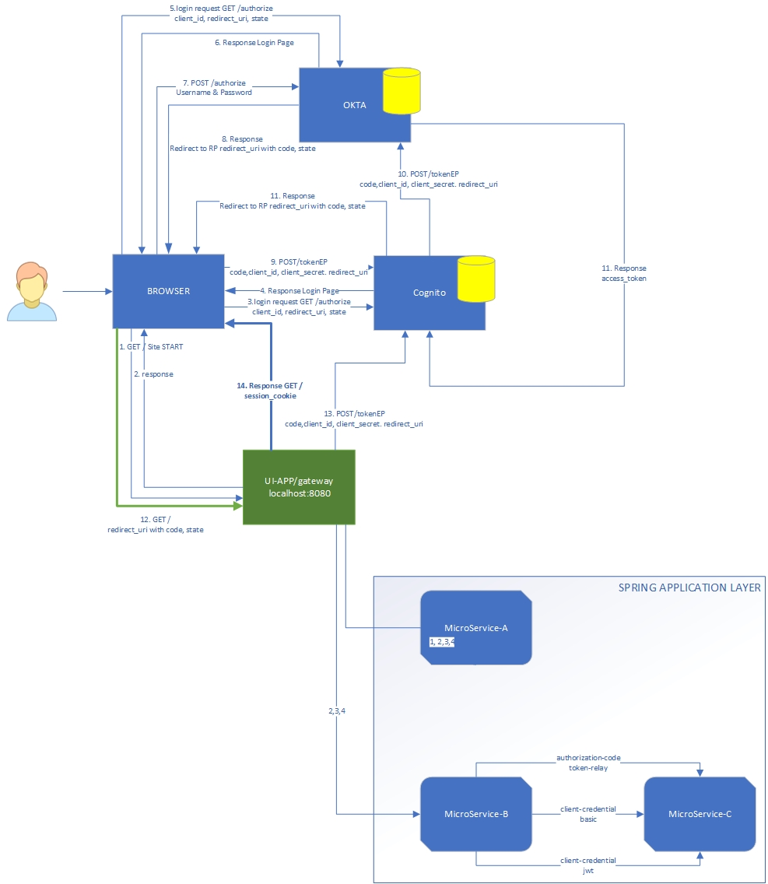
The flow in a topology Diagram For Federated IDP To Okta Through Cognito ?

Slide 11
The pkce App

Slide 12
DEMO PKCE
https://d6c9g2r8kbsr.cloudfront.net/index.html

Slide 13
Main Take away !!
Spring Security Token Patterns: token-re-use, token-relay, token-exchange
IDP Federation introduces a secondary set of calls for the GRANT Flow in question.
Scope’s in Cognito are different and contain a resource identifier.
We verified that federation to Okta IDP from Cognito using OIDC/Oauth is possible.
PKCE is supported
Basic grant method is only supported for obtaining access tokens with client-credential flow.
Setting up of Okta for client-credential flow is not simple but this adds additional layer of security not exposing client-secrets!!.
Abstraction and automation are key.

